Slide 1
Memory Hierarchy
Computer systems employ a memory hierarchy.
At higher levels, memory is faster, smaller & more expensive.
Data is copied between adjacent levels
Within the CPU, there is a set of registers that function at a level above main memory & cache in the hierarchy.

Slide 2
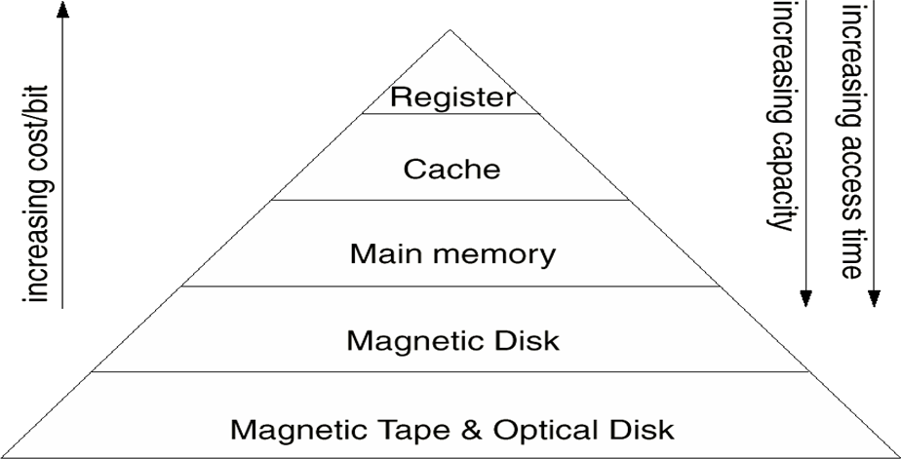
Memory Hierarchy

Slide 3
Going Down the Hierarchy
Decreasing cost per bit
Increasing capacity
Increasing access time
Decreasing frequency of access of the memory by the processor
  locality of reference

Slide 4
How does the memory hierarchy work?
Principle of Locality
What is it?
  Programs access a relatively small portion of the address space at any instant of time.
There are two different types of locality:
  Temporal locality is the locality in time which says if an item is referenced, it will tend to be referenced again soon.
  Spatial locality is the locality in space. It says if an item is referenced, items whose addresses are close by tend to be referenced soon

Slide 5
Cache Memory

Slide 6
Processor - Memory Gap (latency)
Memory speed has not kept up with Processor speed
1000
µProc
60%/yr.
(2X/1.5yr)
CPU
“Moore’s Law”
100
Processor-Memory
Performance Gap:
(grows 50% / year)
Performance
10
DRAM
9%/yr.
(2X/10 yrs)
DRAM
1
1980
1981
1982
1983
1984
1985
1986
1987
1988
1989
1990
1991
1992
1993
1994
1995
1996
1997
1998
1999
2000
Time

Slide 7
Cache Memory
Generally speaking
  The CPU asks for data/instructions from memory faster than it receives from them.
  This type of waiting is bad for performance
Much of the time data and instructions are used over and over. (e.g. loop)
Sometimes you can ‘predict’ what instructions are next
  We can use these tendencies to advantage by keeping likely to be referenced (soon) data in a faster memory than main memory
Rely on caches to bridge gap

Slide 8
Cache Memory
This faster memory is called a CACHE.
  It is located very close to the processor.
  It contains frequently used data & instructions
  It contains COPIES of PARTS of memory.
Memory access (for an instruction fetch or to get operands or to write results) goes to the cache.
Question: Where does the data from cache go to?
CPU
Main Memory
Cache

Slide 9
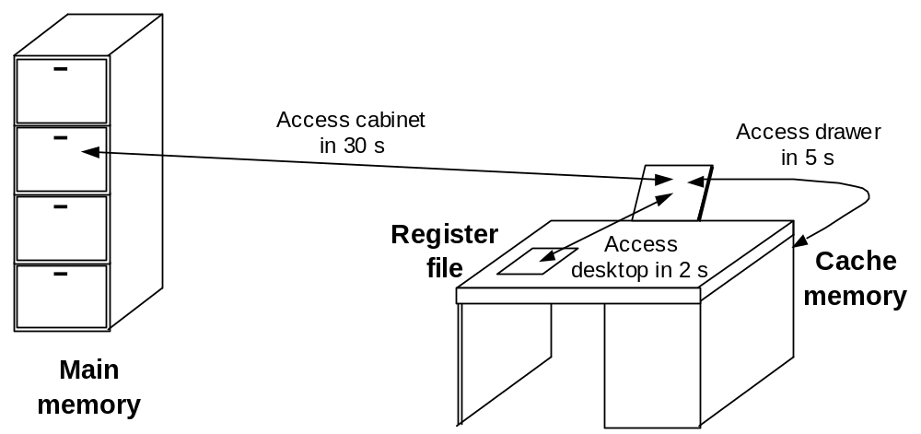
Desktop, Drawer, and File Cabinet Analogy
Once the “working set” is in the drawer, very few trips to the file cabinet are needed.
Items on a desktop (register) or in a drawer (cache) are more readily accessible than those in a file cabinet (main memory).

Slide 10
Performance Advantages
“Locality of reference” is why caching works
  Most memory references confined to small region of memory at any given time
  Well-written program in small loop, procedure or function
  Data likely in array
  Variables stored together

Slide 11
Locality Example
sum = 0;
for (i = 0; i < n; i++)
sum += a[i];
return sum;
Locality Example:
  Data
    Reference array elements in succession :
    Reference sum each iteration:
  Instructions
    Reference instructions in sequence:
    Cycle through loop repeatedly:
Spatial locality
Temporal locality
Spatial locality
Temporal locality

Slide 12
Quick Review Question 1
Consider the following code:
  for ( i = 0; i < 20; i++ )
  for ( j = 0; j < 10; j++ )
  a[i] = a[i] * j
Give one example of the spatial locality in the code.
Give one example of the temporal locality in the code.
Notes:
.

Slide 13
Cache Terminology (1)
A cache “hit” is when the CPU looks in cache and gets what it needs without going to memory.
A cache “miss” is the opposite and causes the CPU to be in a ‘wait state’ (these are bad)
  When a miss occurs the required data must be fetched from main memory.
Hit ratio of 90% is common with the amounts of cache in current use - results in increases in overall processing speed of up to 50%
Even small amount of cache results in high hit ratio

Slide 14
Cache Terminology (2)
Miss penalty: time to replace a block from lower level, including time to replace in CPU
  access time to lower level = f(latency to lower level)
  transfer time: time to transfer block =f(bandwidth)
  E.g. Hit time = 1 cycle, Miss penalty = 50 cycles
Reducing Miss Rate :
  Larger block size
  Larger Caches
  Multi-level Caches

Slide 15
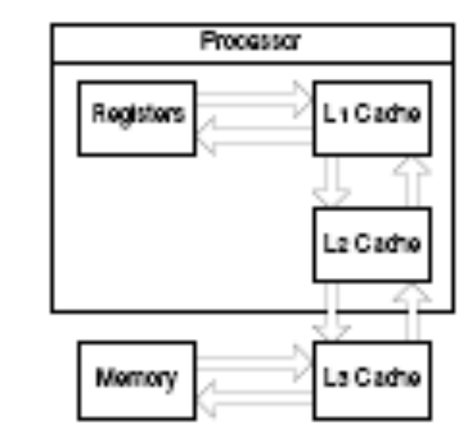
Design Issues (1)
It is possible to split the cache into a hierarchy as well:
Note that some of the caches live on the same chip as the
processor, others don’t:
  On-chip caches are faster, no messy interface to deal with.
  Only so much can fit on-chip, so on-chip caches can only be small whereas off-chip caches can be larger.

Slide 16
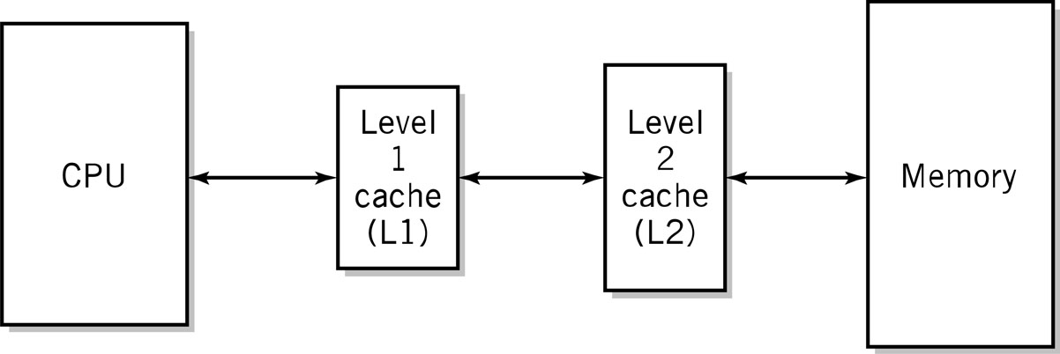
Quick Review Question 2
Why do we have multiple levels of cache?

Slide 17
Quick Review Question 3
Why do the sizes of the caches have to be different?

Slide 18
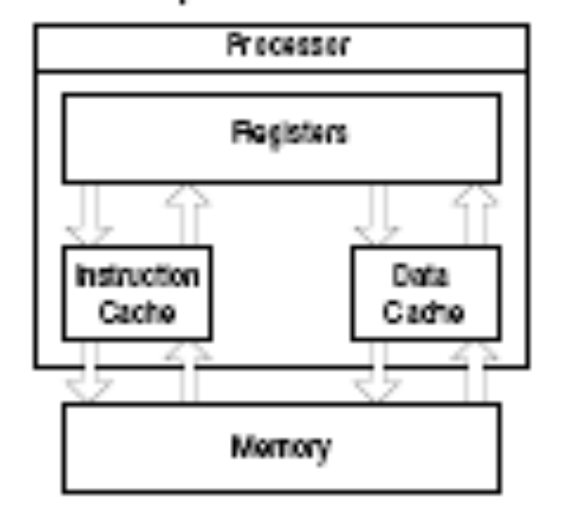
Design Issues (2)
Level 1 has separate caches for instructions and data - called split cache - with independent access to main memory
  Harvard architecture
Level 2 unified cache generally mixture of data and instructions
  Von Neumann architecture

Slide 19
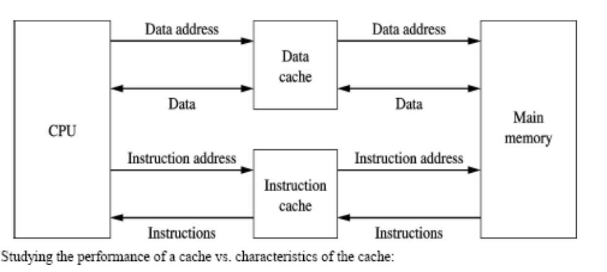
Quick Review Question 4
Why is the L1 cache split?

Slide 20
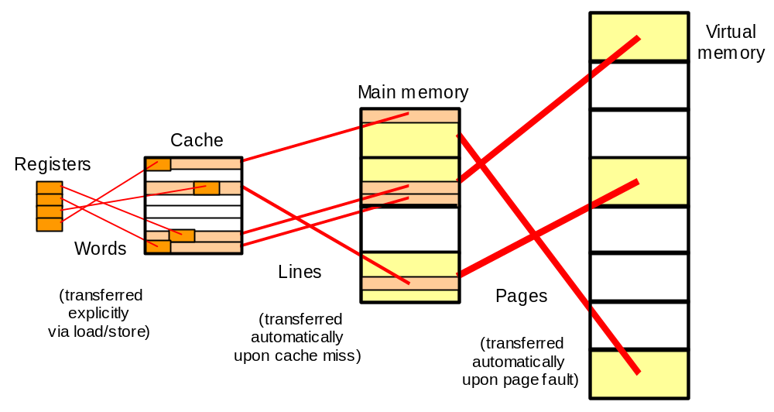
Summary of Memory Hierarchy
Cache memory: provides illusion of very high speed
Main memory: reasonable cost, but slow & small
Virtual memory: provides illusion of
very large size
Data movement in a memory hierarchy.

Slide 21
How is the hierarchy managed?
Registers <-> Memory
  by compiler (programmer?)
cache <-> memory
  by the hardware
memory <-> disks
  by the hardware and operating system (virtual memory)
  by the programmer (files)

Slide 22
Memory Organisation

Slide 23
The Operation of Memory
Main memory consist of cells, each of which can hold a single value and each of which has a single address.
The MAR & MDR acts as an interface between the CPU & memory.
  MDR is also called memory buffer register.
The MAR holds the address to be “opened”.
The MAR is connected to a decoder that interprets the address and activates a single address line into the memory.

Slide 24
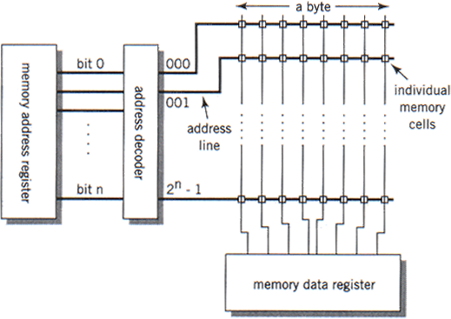
Memory Organisation

Slide 25
The Operation of Memory
Each memory location has a unique address
Address from an instruction is copied to the MAR which finds the location in memory
CPU determines if it is a store or retrieval
Transfer takes place between the MDR and memory
MDR is a two way register

Slide 26
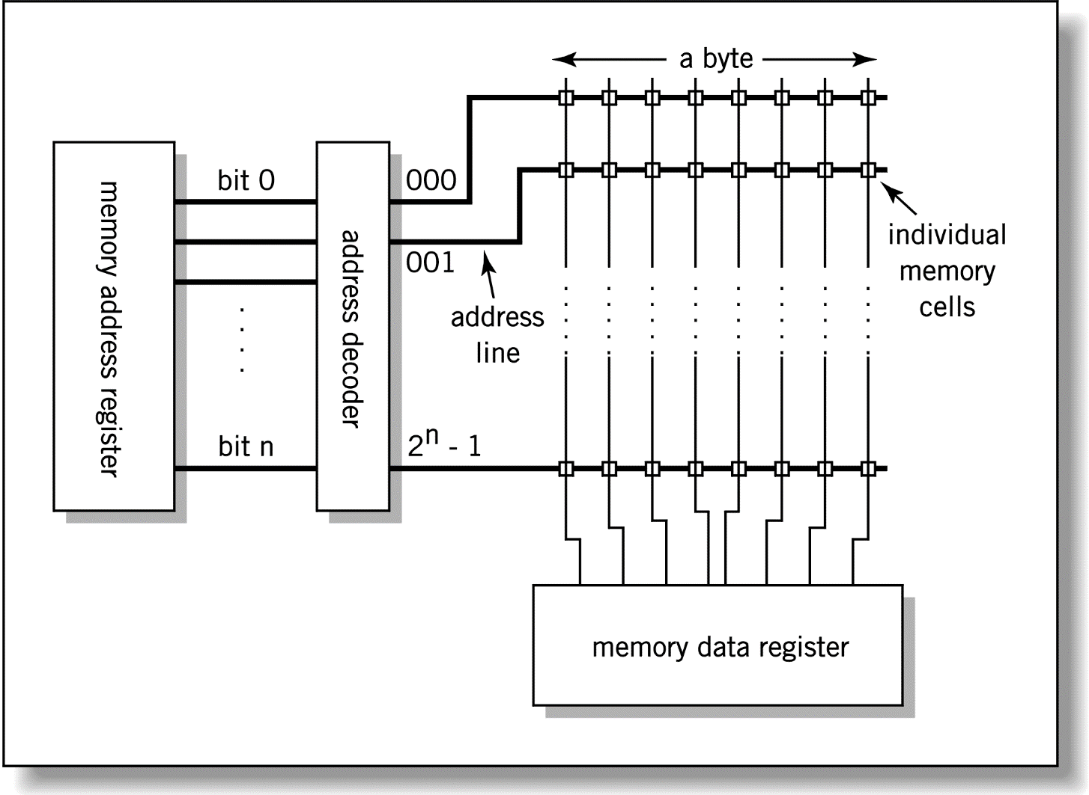
Relationship between MAR,
MDR and Memory
Address
Data

Slide 27
The Operation of Memory
The output from the MAR is passed to the address decoder.
The row of memory cells corresponding to the decoded address will be activated.
The MDR will read this group of cells.

Slide 28
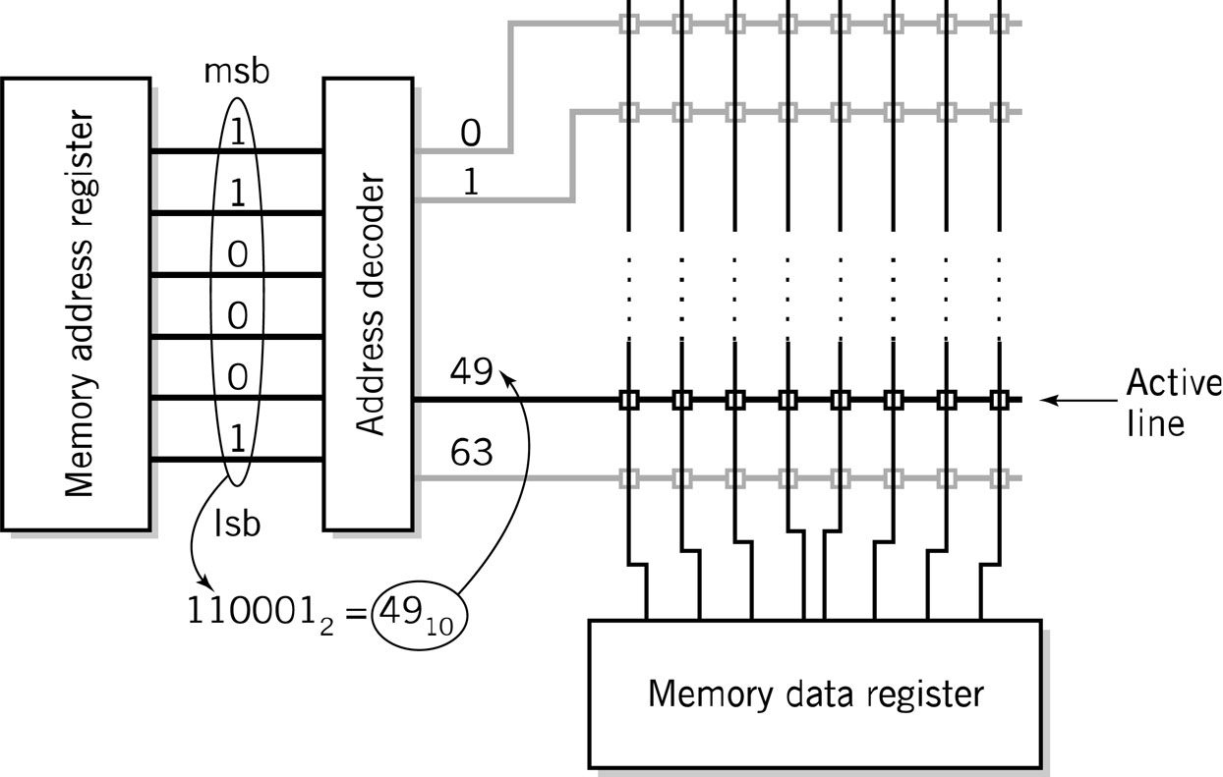
MAR-MDR Example

Slide 29
Quick Review Question 5
If the MAR holds 32 bits, what is the maximum size of the memory unit on this machine?
If the MAR holds 40 bits, what is the address of the last memory cell in this machine?
A memory system has a total of 64 chips. Each memory chip has 8 address lines and 8 data lines.
  How many bits of memory are present in the memory system? Show your work. (5 points)
Notes:
One large modern computer has a 64-bit memory address register. How much memory can this computer address? A 64-bit MAR can support 2 64 = 2 34 x 2 30 = 2 34 gigabytes of addressable memory.
A memory system has a total of 64 chips. Each memory chip has 8 address lines and 8 data lines. How many bits of memory are present in the memory system? Show your work. (5 points)
(iv) 2**8 x 8 = 4K bits per chip. 4K x 64 = 32Kbytes total

Slide 30
Memory Capacity
Memory Capacity is the maximum number of addressable memory locations.
Let the size of the address be ‘k’ bits and the number of addressable memory locations be ‘M’ locations.
Then => M = 2^{k} locations
If each location can accommodate B bytes, then memory capacity in bytes is (2^{k} * B).

Slide 31
Memory Capacity
2^{n} x m
n - address bits = 2^{n} addresses
m - data bits
m - the “width” of the data path
Typical values:-
  n: 16, 17, 18, 19, 20, 21, 22, etc.
  m: 8, 16, 32, 64

Slide 32
Quick Review Question 6
Determine the memory capacities (in bytes, MB or GB) of the following computer configurations:-
  Memory address register of 16bits and word size of 12bits.
  Memory address register of 24bits and word size of 8bits.
  Memory address register of 32bits and word size of 16bits.
  Memory address register of 64bits and word size of 24bits.
Show how you mathematically derive the values for each of the above.
Notes:
((2^16)*12)/8/1024/1024 = 0.09375MB
((2^24)*8)/8/1024/1024 = 16MB
((2^32)*16)/8/1024/1024 = 8192MB
((2^64)*24)/8/1024/1024 = 51539607552GB

Slide 33
Quick Review Question 7
How many bits of memory are contained in a memory unit with 512KB of memory locations?
How many bits of memory are contained in a memory unit with 2MB of memory locations?
One large modern computer has a 36 bit memory address register. How much memory can this computer address?
Notes:
Q1
512 = 2⁹, K = 2¹⁰, B = byte = 8bits = 2³
2⁹ x 2¹⁰ x 2³ = 2²² = 4,194,304 bits
Q2
2 = 2¹, M = 2²⁰, B = byte = 8bits = 2³
2¹ x 2²⁰ x 2³ = 2²⁴ = 16,777,216 bits
Q3
MAR = 36bits
Total addressable locations = 2³⁶ = 68719476736 = 64GB

Slide 34
Quick Review Questions
What are the differences between registers, cache and main memory?
In what order does the Processor search for data or instructions?
What are the two (2) major types of RAM?
What are differences between the two types of RAM?
For what parts are the 2 types of RAM used?

